Slide 1


Slide 2


Javier Suárez Ruiz
Visual Studio Technologies & Windows Platform Development MVP
Xamarin MVP
Software Developer Plain Concepts
Blog: http://geeks.ms/blogs/jsuarez
Email: javiersuarezruiz@hotmail.com
Twitter: @jsuarezruiz

Slide 3
Interfaces nativas Cross-Platform con Xamarin.Forms
Javier Suárez Ruiz
@jsuarezruiz

Slide 4
Conoce Xamarin.Forms
Crear UIs nativas para iOS, Android, y Windows
Desde un mismo archivo común, compartido C#.

Slide 5
Xamarin + Xamarin.Forms
iOS C# UI
Android C# UI
Windows C# UI
Shared UI Code
Shared C# Backend
Shared C# Backend
Enfoque tradicional de Xamarin
Con Xamarin.Forms: Más código compartido, todo nativo

Slide 6
¿Qué se incluye?
✓ 40+ páginas, layouts, y controles
(code behind o XAML)
✓ Two-way data binding
✓ Mavegación
✓ API de animaciones
✓ Dependency Service
✓ Messaging Center
Shared UI Code
Shared C# Backend

Slide 7

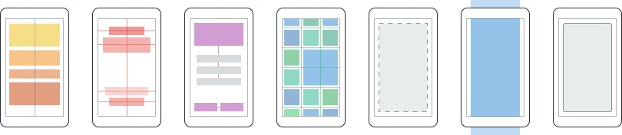
Layouts
Páginas
Content
MasterDetail
Navigation
Tabbed
Carousel
Stack
Absolute
Relative
Grid
ContentView
ScrollView
Frame
Notes:
Inside of a page are layouts
A lot of options from something simple like a stack panel to complex and powerful grids

Slide 8
Controles
ActivityIndicator
BoxView
Button
DatePicker
Editor
Entry
Image
Label
ListView
Map
OpenGLView
Picker
ProgressBar
SearchBar
Slider
Stepper
TableView
TimePicker
WebView
EntryCell
ImageCell
SwitchCell
TextCell
ViewCell

Slide 9


El ecosistema Xamarin.Forms

Slide 10
Comparativa de controles
Windows | Xamarin.Forms
StackPanel | StackLayout
TextBox | Entry
ListBox | ListView
CheckBox | Switch
ProgressBar | ActivityIndicator
Grid | Grid
Label | Label
Button | Button
Image | Image
Date/TimePicker | Date/TimePicker

Slide 11
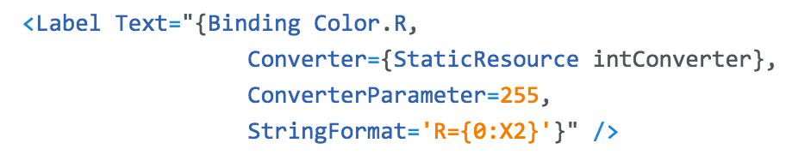
Windows | Xamarin.Forms
DataContext | BindingContext
{Binding Property} | {Binding Property}
ItemsSource | ItemsSource
ItemTemplate | ItemTemplate
DataTemplate | DataTemplate
Comparativa de enlace a datos

Slide 12
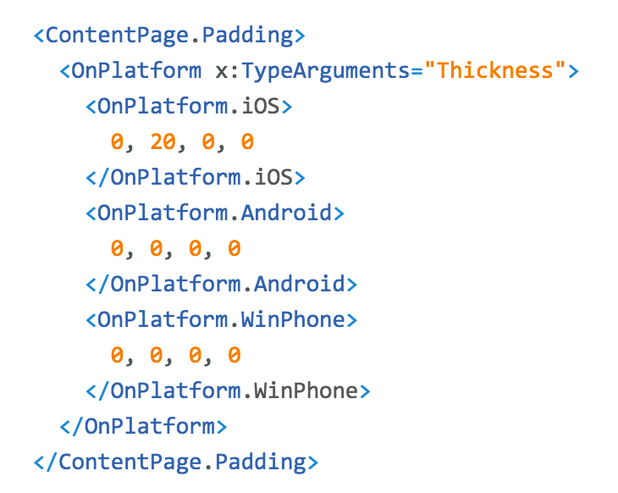
Personalización de la plataforma

Slide 13
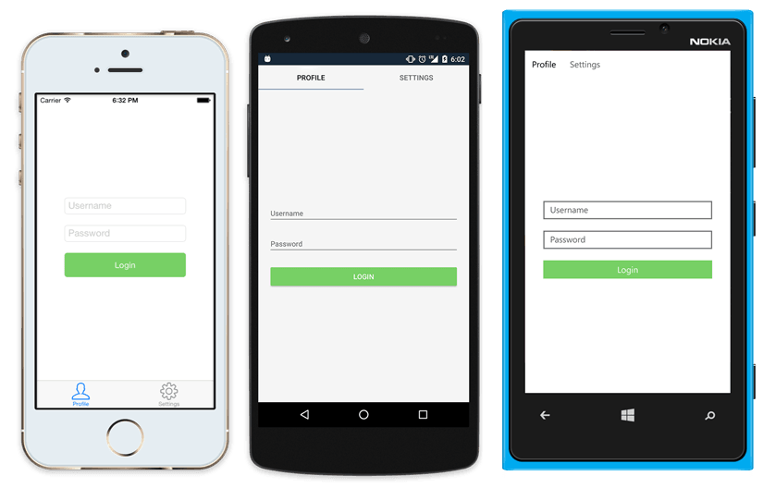
UI Nativa desde código compartido
<?xml version="1.0" encoding="UTF-8"?>
<TabbedPage xmlns="http://xamarin.com/schemas/2014/forms"
xmlns:x="http://schemas.microsoft.com/winfx/2009/xaml"
x:Class="MyApp.MainPage">
<TabbedPage.Children>
<ContentPage Title="Profile" Icon="Profile.png">
<StackLayout Spacing="20" Padding="20"
VerticalOptions="Center">
<Entry Placeholder="Username"
Text="{Binding Username}"/>
<Entry Placeholder="Password"
Text="{Binding Password}"
IsPassword="true"/>
<Button Text="Login" TextColor="White"
BackgroundColor="#77D065"
Command="{Binding LoginCommand}"/>
</StackLayout>
</ContentPage>
<ContentPage Title="Settings" Icon="Settings.png">
<!-- Settings -->
</ContentPage>
</TabbedPage.Children>
</TabbedPage>

Slide 14
Xamarin.Forms Demo

Slide 15
Últimas novedades en Xamarin.Forms

Slide 16
Xamarin.Forms es Open Source!
open.xamarin.com

Slide 17
XAML Previewer

Slide 18
Xamarin.Forms Previewer Demo

Slide 19
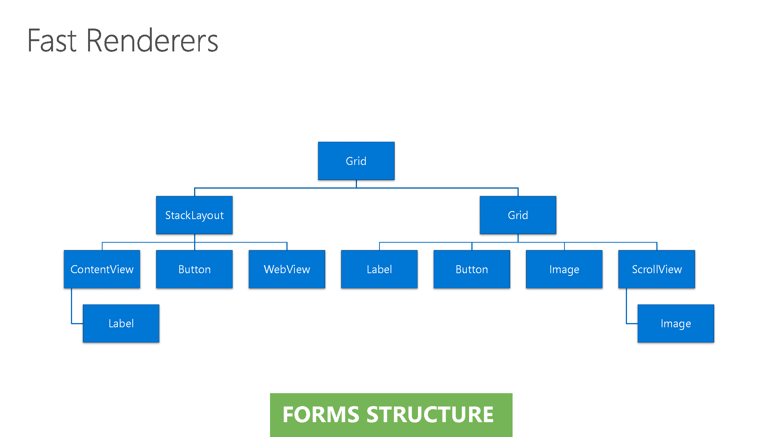

Slide 20
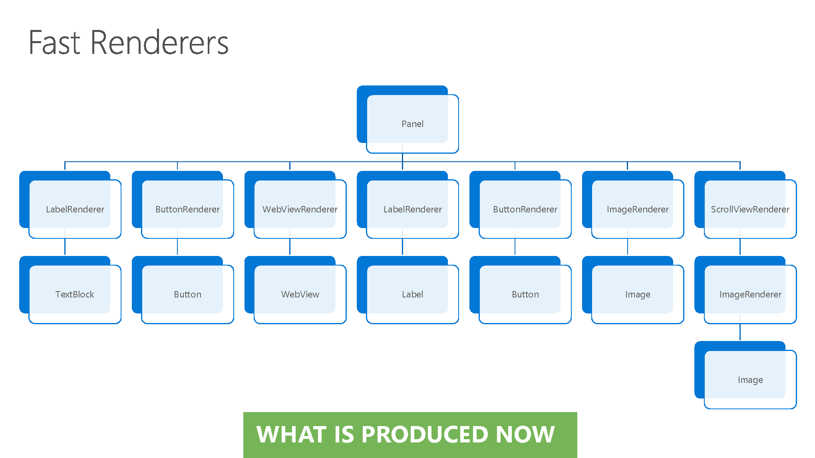

Slide 21
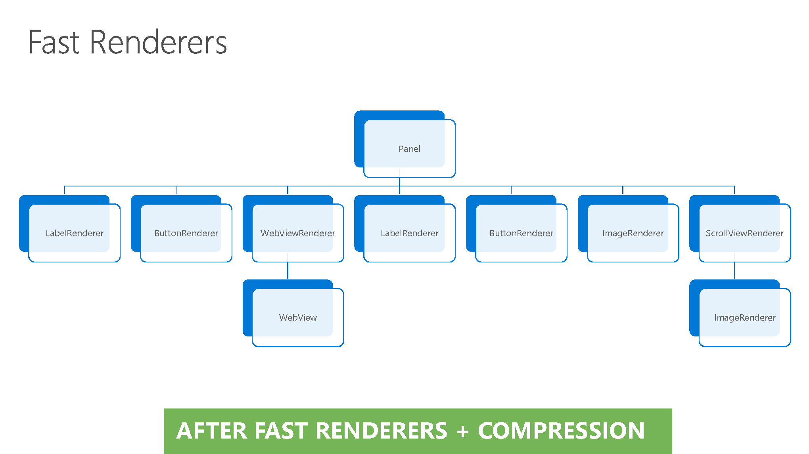

Slide 22
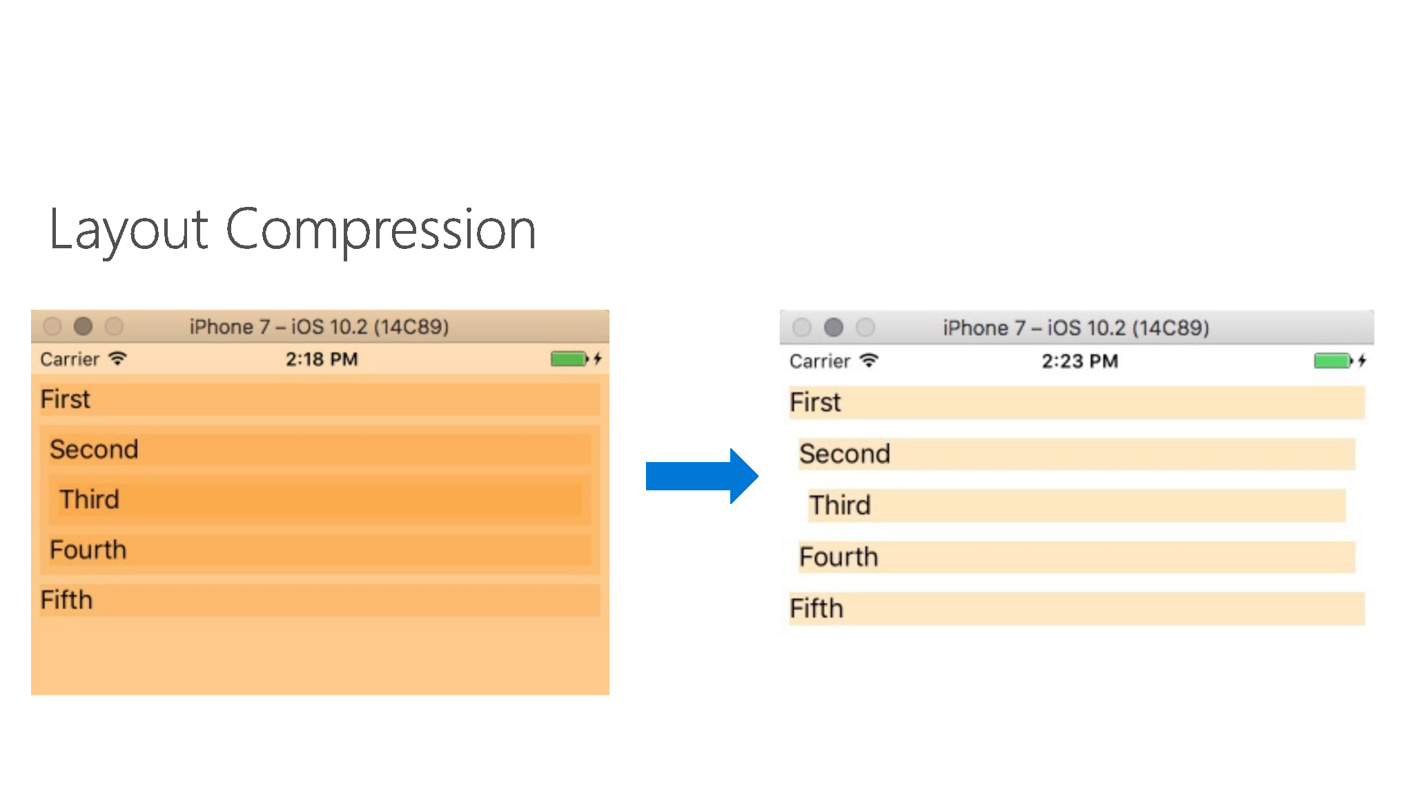

Slide 23
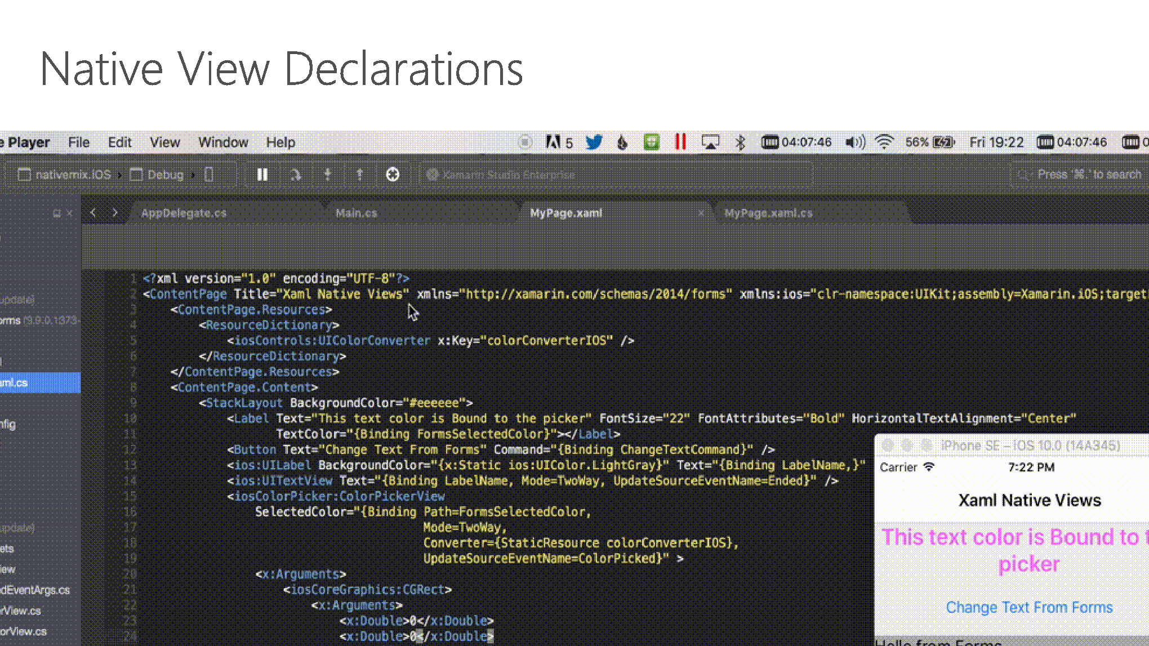

Slide 24
Native Views Demo

Slide 25
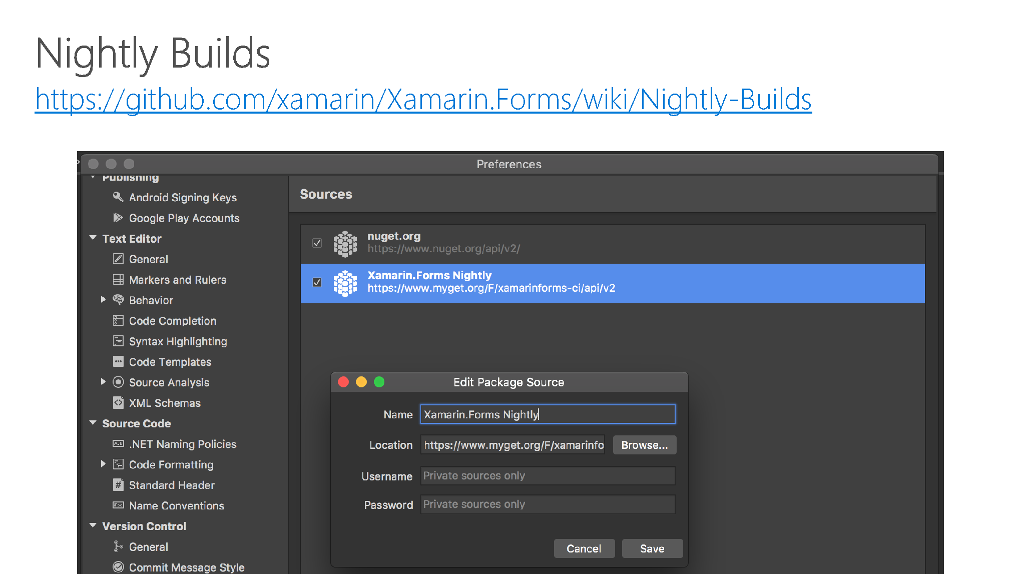

Slide 26
10 Minutos de descanso
Javier
Suárez Ruiz
javiersuarezruiz@hotmail.com
https://javiersuarezruiz.wordpress.com
@jsuarezruiz

